Slide 1
SG8002 Lesson 1
Semester A 2021-2022

Slide 2

Introductions
Instructor
Students
-Your name?
-Country?
-Department and Research Area?
-Non-academic interests?
-Your ‘passion(s)’ in life?

Slide 3

SG8002 – Course Information
The course is designed to help you improve your English for the Medium of Instruction, including listening, pronunciation, stress, intonation, vocabulary and explanation strategies…
…but you will need to continually practice them over the long term in order to be able to teach some day in English
Successful outcomes depend on your commitment, persistence and continued hard work

Slide 4
Course Intended Learning Outcomes (CILOs)
CILOs | Upon successful completion of this course, students will be able to provide various types of comprehensible oral instruction: (underlined words = difficult.)
1 | with adequate fluency in English;
2 | with adequate grammatical precision and register appropriateness; https://www.enotes.com/homework-help/what-register-linguistics-786574
3 | with adequate command of prosodic features of English;
4 | with appropriate command of lexis and communicative functions necessary for teaching in their general discipline area. http://dictionary.cambridge.org/dictionary/english/lex
5 | Students will also be able to hold coherent, sustained academic discussion with their students on matters within their general discipline area.

Slide 5
Session / Topic | Activities
Lesson 1: Course Introduction / IPA / Suggested-ed /Online Resources/ Simple Explanation Strategies | Course and assessment introduction and information Understanding the CILOs Recognising and pronouncing International Phonetic Alphabet (IPA) symbols Teacher’s suggestions of high quality online resources & other tools for improving speaking and listening Teaching Strategy 1: Simple Explanation Strategies (2-3 min each) Teaching demonstrations in pairs using Explanation Strategies Homework – Become familiar with suggested online resources & tools Register for OPTIMUS
Lesson 2: Revision of Lesson 1 / Word Stress/ Definition and Classification/ Week 2 Presentation Skills / Mini-teaching demonstration | Brief revision of Lesson 1 (IPA; online tools; simple explanation strategies) The importance of Word Stress (and related activities) Teaching Strategy 2: Definition and Classification Week 2 presentation skills: smiling, speaking clearly, using hand gestures and signposting (as in You tube video: ‘Learn biology: biodiversity definition’) (2-3 min each) Teaching demonstration using Definition and Classification Introduction to OPTIMUS website Homework - complete homework form and reflection on OPTIMUS focusing on this week’s (and other) presentation features
Lesson 3: Revision of Lesson Two / Sentence Stress, Rhythm & Intonation / Comparison and Contrast / Week 3 Presentation Skills / Mini-teaching demonstration | Brief revision of Lesson 2 – (Word Stress, Definition and Classification; smiling, speaking clearly, hand gestures, signposting) Sentence Stress, Rhythm & Intonation (and related activities) Teaching Strategy 3: Comparison and Contrast Week 3 presentation skills: Word and sentence stress; Chunking (3-4 min each) Teaching demonstration using Comparison and Contrast Submit Week 2 OPTIMUS homework form to teacher Homework – complete homework form and reflection on OPTIMUS focusing OPTIMUS videos watched focusing on this week’s (and other) presentation features
Lesson 4: Lesson Three Revision / Week 4 Presentation Skills / Process / Mini-teaching demonstration / Explain Final Assessment | Brief revision of Lesson 3 – (Sentence Stress, Rhythm & Intonation, chunking) Week 4 presentation skills: Making eye contact while using chunking Teaching Strategy 4: Process (4-5 min each) Teaching demonstration using Process Explanation of Final Assessment and distribution of assessment materials Submit Week 3 OPTIMUS homework form to teacher Homework – complete reflection form on OPTIMUS videos watched focusing on this week’s (and other) presentation features
Lesson 5: Lesson Four Revision / Cause and Effect / Week 5 Presentation Skills / Mini-teaching demonstration / Assessment tips | Brief revision of Lesson 4 main points (Process) Teaching Strategy 5: Cause and Effect Week 5 presentation skills: Avoiding poor presentation/teaching habits (videos) (5 min each) Teaching demonstration using Cause and Effect Further explanation of Final Assessment; reminder of schedule for final assessment; teacher tips for success; teacher answers questions about final assessment. Submit Week 4 OPTIMUS homework form to teacher Homework – 1. Complete homework form and reflection on OPTIMUS videos watched focusing on this week’s (and other) presentation features. 2. Prepare for final assessment using all of that was taught in the course.
Lesson 6: Final Assessment | Submit hard copy of assessment material to teacher Submit Week 5 OPTIMUS homework form to teacher Do a 5-min teaching English teaching demonstration (to be videoed)

Slide 6
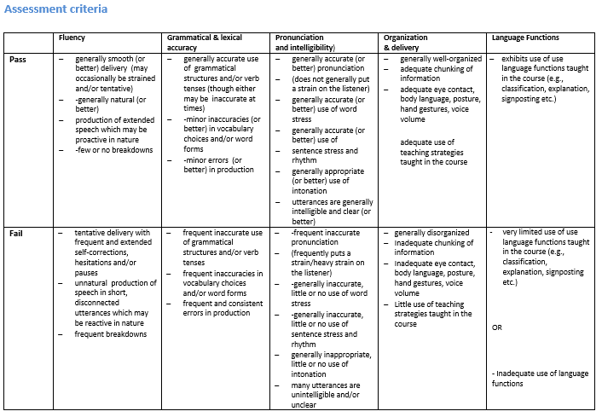
Assessment Criteria
Students will be required to do a short teaching demonstration in English for the Medium of Instruction.
Each student will be given a topic related to their discipline in advance and will need to prepare a five minute teaching demonstration.

Slide 7

Canvas
The student booklet is available on the Canvas course site.

Slide 8
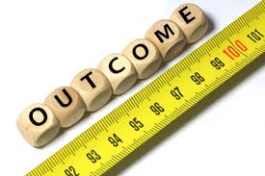
Today’s Intended Learning Outcomes
By the end of this session, you should be able to:
understand the Course Intended Learning Outcomes (CILOs)
understand the course assessment and assessment criteria
become familiar with the 44 International Phonetic Alphabet (IPA) symbols
locate and use high quality online resources for improvement of spoken English
use explanation strategies to teach simple and abstract concepts

Slide 9
Today’s Intended Learning Outcomes
The course is designed to help students improve their English for the Medium of Instruction, by improving their pronunciation, stress, intonation, rhythm, listening, presentation skills, vocabulary and explanation strategies. Students will need to work independently and continually practise in these areas in the long term to be able to teach in English. Successful outcomes depend on students’ commitment, persistence and continued hard work!

Slide 10
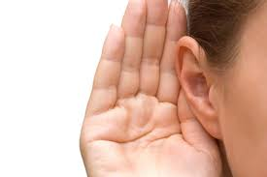
The importance of listening
Speaking is closely connected to listening. (One cannot be done without the other.)
To become an accurate speaker, you need to listen carefully to accurate speaking.
Speaking with clear pronunciation (proper voicing of consonants and vowels, correct intonation, etc.) requires good listening comprehension and listening to high quality input.

Slide 11
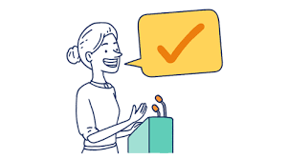
Speaking Clearly:Three points to remember
Speaking clearly and accurately can be divided into three main areas:
Pronunciation of sounds, with proper voicing of consonants and vowels
Pronunciation of individual words, including stress
Proper rhythm (sentence stress) and intonation of sentences or word groups
Therefore, learning effective oral production of 1) sounds, 2) words, and 3) word groups is important for communicating well when teaching in English.

Slide 12
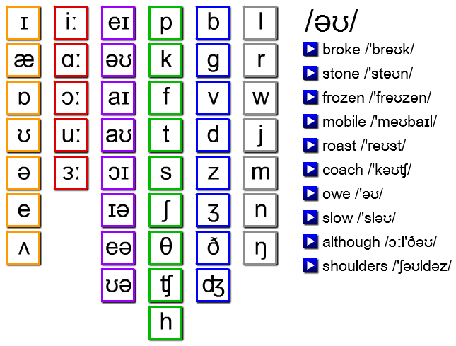

The international Phonetic alphabet (IPA) - Pronunciation of sounds

Slide 13
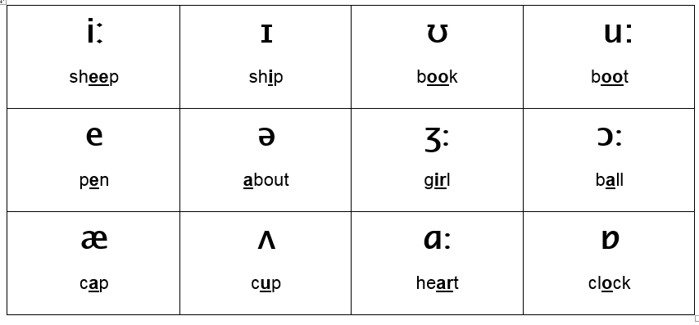
Individual Vowel Sounds (Monophthongs) listen and repeat after the teacher

Slide 14
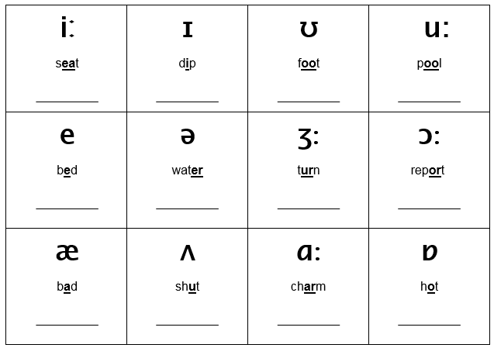
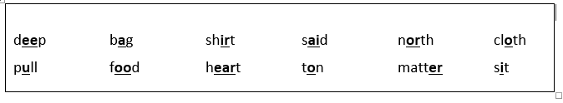
Individual Vowel Sounds (Monophthongs) Write the words below under the correct IPA symbol

Slide 15

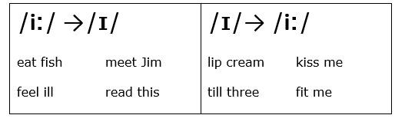

Individual Vowel Sounds (Monophthongs) Practise saying the sounds accurately
Record yourself on your phone and listen for accuracy.

Slide 16
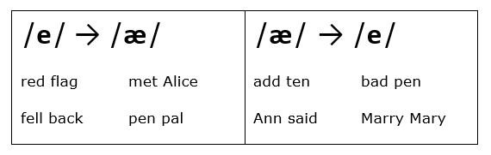
Individual Vowel Sounds (Monophthongs) Practise saying the sounds accurately
Record yourself on your phone and listen for accuracy.

Slide 17
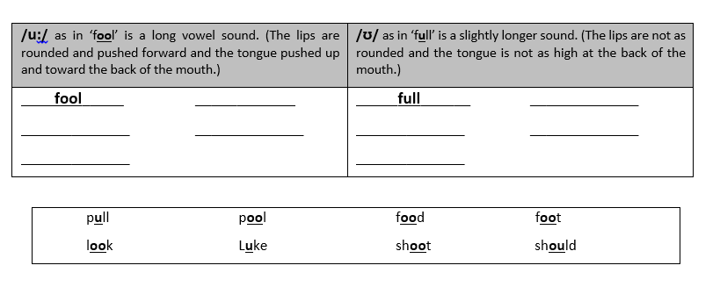
Individual Vowel Sounds (Monophthongs) Write the words below under the correct IPA symbol

Slide 18
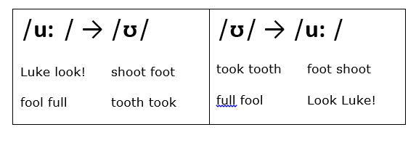
Individual Vowel Sounds (Monophthongs) Practise saying the sounds accurately
Record yourself on your phone and listen for accuracy.

Slide 19
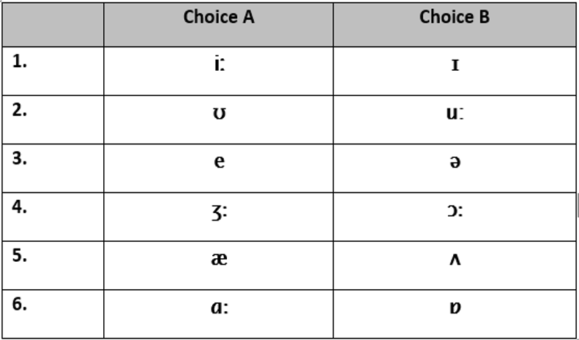
Individual Sounds: Vowels (Monophthongs) Circle the sound your teacher says

Slide 20
Individual Sounds: Vowels (Monophthongs) Circle the sound your partner says. Switch roles after.

Slide 21
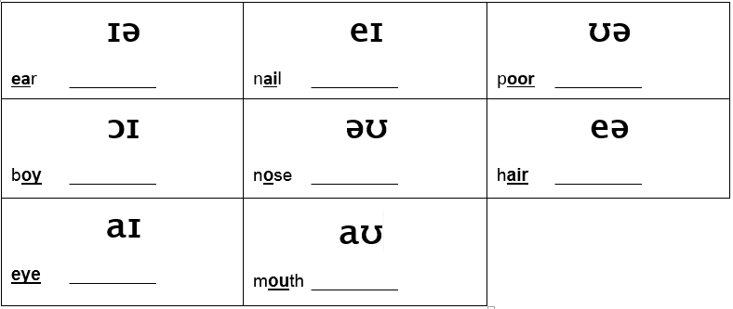
Diphthongs: Two combined vowel Sounds Practise saying the sounds accurately

Slide 22

Two combined vowel Sounds: Diphthongs Write the words below under the correct IPA symbol

Slide 23
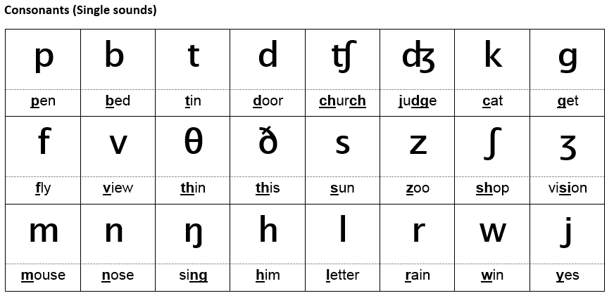
Individual sounds: Consonants Practise saying the sounds accurately

Slide 24
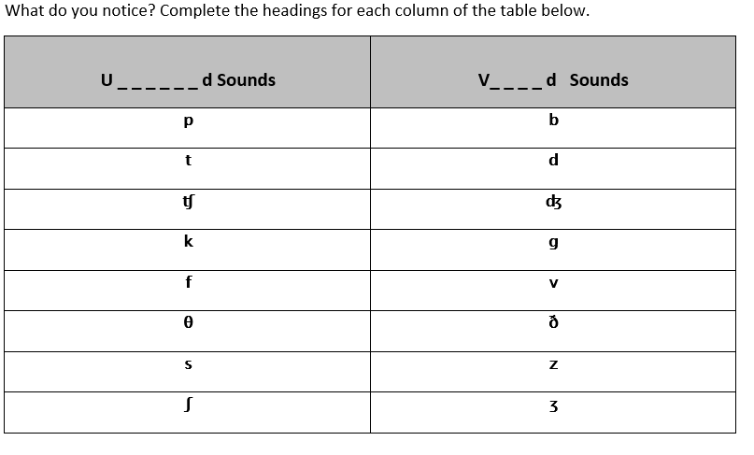
Individual sounds: Consonants

Slide 25

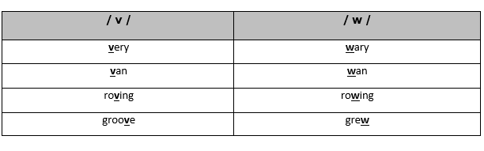
Individual sounds: Consonants
Practise:
1. Groves of vine veered west along the villain’s veranda.
2. Woollen vests for wailing wolves are worn in the vast woodlands.
Record yourself on your phone and listen for accuracy.

Slide 26
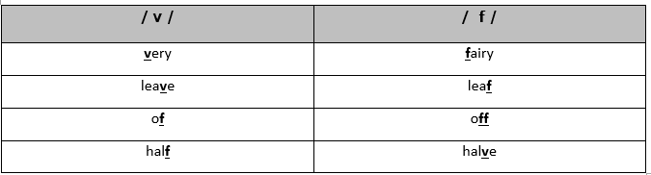
Individual sounds: Consonants
Practise:
1. Vivacious Vivian vacuumed Vincent’s very vivid vase.
2. Victoria vowed vengeance vociferously and vehemently.
Record yourself on your phone and listen for accuracy.

Slide 27
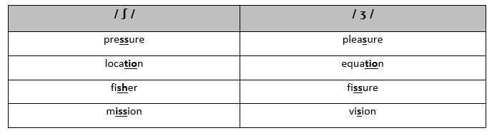
Individual sounds: Consonants
Practise:
1. Casual clothes are provisional for leisurely trips across Asia.
2. His treasure was measured in non-visual pleasure.
Record yourself on your phone and listen for accuracy.

Slide 28
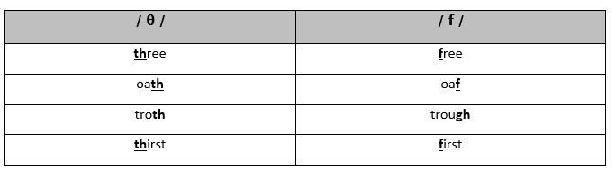
Individual sounds: Consonants
Practise:
1. Tom threw thirty three thousand thorny thistles.
2. Through three cheese trees three free fleas flew.
Record yourself on your phone and listen for accuracy.

Slide 29
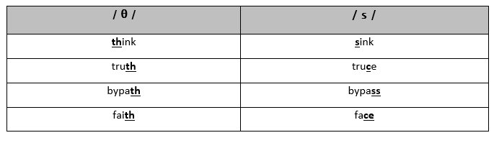
Individual sounds: Consonants
Practise:
1. Thelma sells thick thistles near the theatre.
2. Cassie threw Cathy some thick math books.
Record yourself on your phone and listen for accuracy.

Slide 30
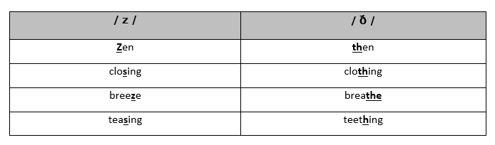
Individual sounds: Consonants
Practise:
1. Zero leather, weathered leather. Zero leather, weathered leather.
2. Mr. Dithers goes hither and thither to lather his withering plants.
Record yourself on your phone and listen for accuracy.

Slide 31

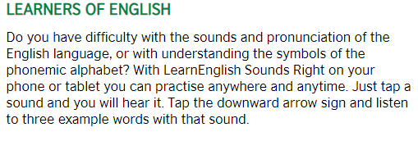
Download and Use the ‘Sounds Right’ App

Slide 32

Using Online Dictionaries to help you Speak Clearly
There are many online dictionaries, but not all are the same high quality. (Choose carefully as some may not offer accurate pronunciation.)
Look at the features of one which does offer accurate pronunciation, like this one:
American: (Macmillan)
www.macmillandictionary.com/dictionary/british/pronunciation
British (Cambridge)
http://dictionary.cambridge.org/
Use these dictionaries regularly.

Slide 33
Using Online Dictionaries to help you Speak Clearly
Please go to then use one of the following dictionaries…
American: (Macmillan)
www.macmillandictionary.com/dictionary/british/pronunciation
British (Cambridge)
http://dictionary.cambridge.org/
…to look up the words on the following page. Practise saying them with a partner.

Slide 34

look up the following words in one of the online dictionaries or in the Pronounce it right app. How are they pronounced?
inelasticity
norepinephrine
colonel
isthmus
anemone
quinoa
onomatopoeia
catastrophic
literature
wool

Slide 35
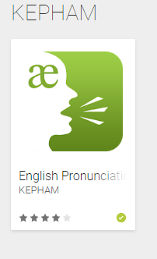
Download and Use the ‘KEPHAM English Pronunciation’ App
https://play.google.com/store/apps/developer?id=KEPHAM&hl=en

Slide 36
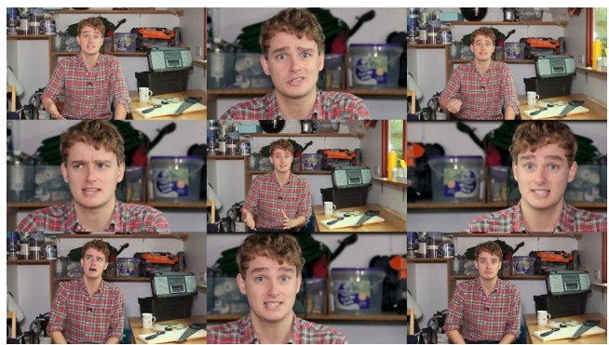
Use the BBC Pronunciation Website:
Google:
‘BBC Pronunciation’ - you will find ‘Tim's Pronunciation Workshop’:
http://www.bbc.co.uk/learningenglish/english/features/pronunciation
Use it often to improve your pronunciation skills!

Slide 37

Explanation Strategies
Explanation strategies are ways to explain something such as an object, idea, etc. to someone who does not know what it is.
Some things may require several explanation strategies.
Effective teachers can use any number of explanation strategies.
The list below contains explanation strategies and language that you can use when explaining things.

Slide 38
Explanation Strategies - Type and Language (1)
Type
Useful Language
name
function
process of using
category / classification
color
composition / material
structure
Its called a ____
It’ used to _____
To use it, first you ___, then ___
It is a kind of________
The color is __ or ____ .
It is made of ________
It is square/ round/ flat/ cylindrical/etc.

Slide 39
Explanation Strategies - Type and Language (2)
Type
Useful Language
dimensions: weight, size, etc.
examples
texture
origin / place of manufacture or production
method of producing it
odor / scent
It’s usually XX grams and XX cm
An example is…
The texture is smooth/ coarse/soft/etc.
It comes from ___
It is made under these conditions: ______
It has a scent like ____

Slide 40
Explanation Strategies - Type and Language (3)
Type
Useful Language
sound
taste
appearance
historical information
who uses it
effect produced
comparison / contrast
It makes a sound like ___
It tastes like ___
It looks like ____
It was invented by ____
Biologist/Engineers/Office worker /Students /Parents/ etc. use it
The effect produced is ___
It is similar to X but different then Y

Slide 41
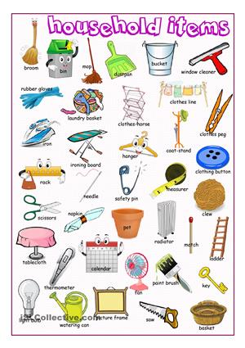

Explanation Strategies – Practice (1)
Your partner is an alien who has just arrived on planet earth. Your alien partner is very curious and wants to know what different things are and what their function is. Use explanation strategies to explain the appearance, function, abilities (etc.) of several items below. Help your alien partner feel more at home here on planet earth!

Slide 42
Language Used for Explanation
It’ used to _____
To use it, first you ___, then ___
It is a kind of________
The color is __ or ____ .
It is made of ________
It is square/ round/ flat/ cylindrical/etc.
It’s usually XX grams and XX cm
An example is…
The texture is smooth/ coarse/soft/etc.
It comes from ___
It is made under these conditions: ______
It has a scent like ____
It makes a sound like ___
It tastes like ___
It looks like ____
It was invented by ____
Biologist/Engineers/Office worker /Students /Parents/ etc. use it
The effect produced is ___
It is similar to X but different then Y

Slide 43
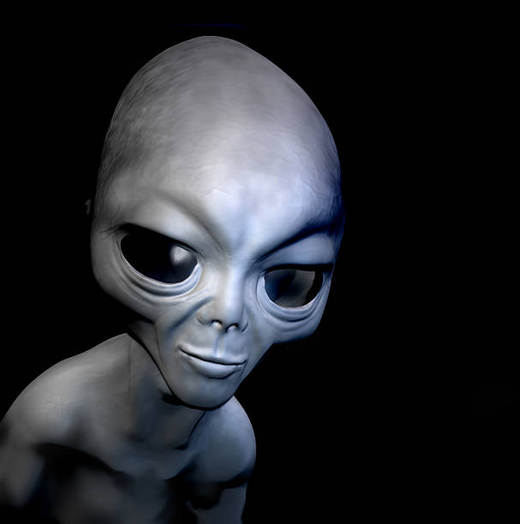
Explanation Strategies – Practice (2)
Imagine your partner is a first time visitor to Planet Earth. Choose several of the following and teach what they are to your alien partner.
Objects
-Classroom projector
-Classroom visualizer
-Bunsen burner
-Driverless cars
-TV remote control
-I-pad
-Electric kettle
-Drone -USB stick
-External hard drive
-Electric guitar

Slide 44
Explanation Strategies – Practice (3)
Explaining Abstract Concepts
Imagine your partner is a first time visitor to Planet Earth. Choose several of the following and teach what they are to your alien partner.
-Evil
-Religion
-Time travel
-Beauty
-Time
-Freedom
-Hope
-Trust

Slide 45
Homework
1. Go through the following apps and websites from today’s lesson and practise sounds that are difficult for you:
Sounds Right (British Council)
https://learnenglish.britishcouncil.org/en/apps/learnenglish-sounds-right
https://play.google.com/store/apps/developer?id=KEPHAM&hl=en
http://www.bbc.co.uk/learningenglish/english/features/pronunciation
Macmillan, Webster (American) or Oxford or Cambridge (British) online dictionaries to pronounce new or difficult words accurately. Practise often!
2. Register for a free OPTIMUS (ONLINE PROJECT FOR THE IMPROVEMENT OF UNIVERSITY SPEAKING) account:
OPTIMUS website:
http://optimus.hku.hk/home/
…select videos to watch and pay attention to each lecturers’ good habits.

Slide 46


Slide 47
